Slide 1
BRITISH COMEDY AND HUMOUR

Slide 2
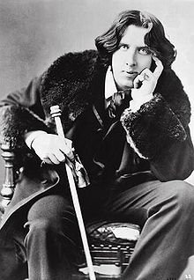
“It is clear that humour is
far more superior than humor.”
– Oscar Wilde

Slide 3
BRITISH COMEDY: THE FOUR S’S
STAND-UP COMEDY
SKETCH
SITCOM
SATIRE

Slide 4
STAND-UP COMEDY
a comedic style in which a comedian performs in front of a live audience, speaking directly to them
“bits” (short jokes, humorous stories)
oneliners
monologue (sometimes: interaction)

Slide 5
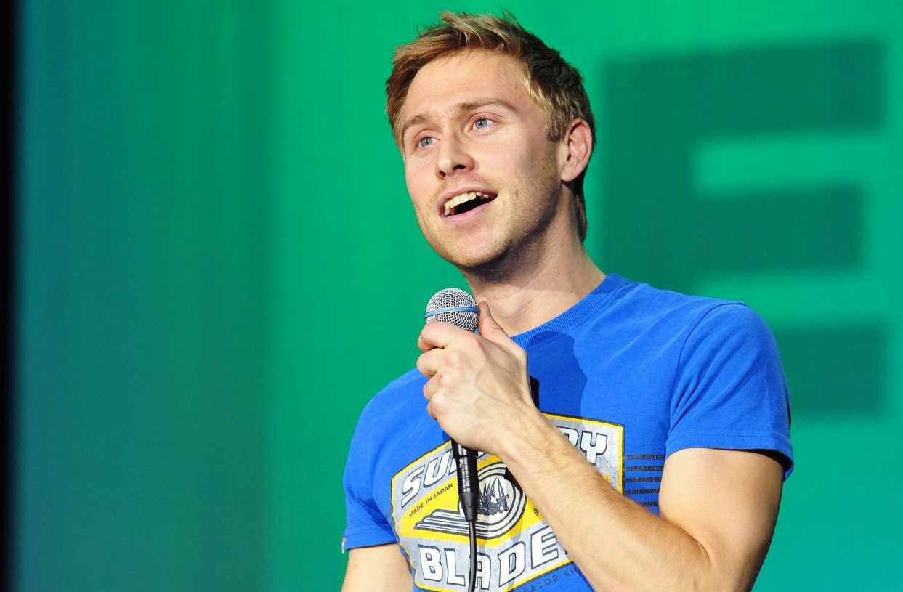
RUSSELL HOWARD

Slide 6
SKETCH
a short comedic scene performed by a group of comic actors or comedians either on stage or through an audio and/or visual medium such as broadcasting
in succession

Slide 7
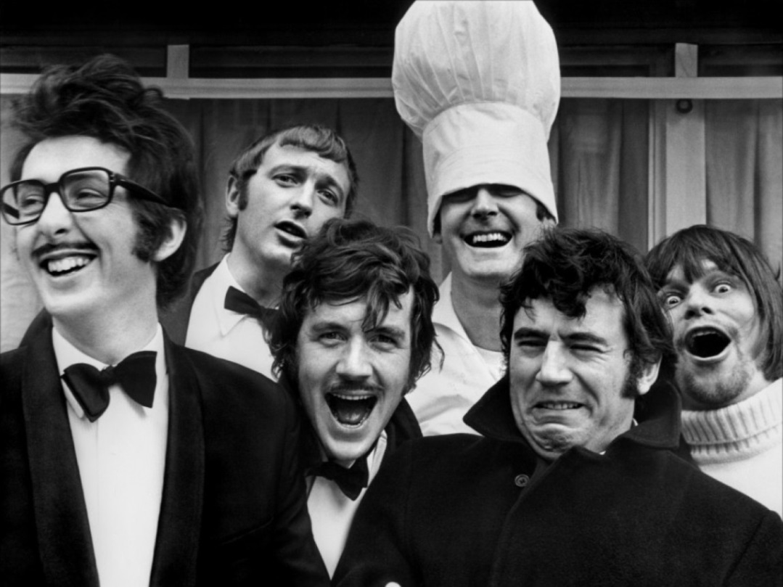
MONTY PYTHON’S FLYING CIRCUS

Slide 8
SITCOM
situation comedy
genre of comedy that features characters sharing the same common environment, such as a home or workplace, accompanied with jokes as part of the dialogue

Slide 9
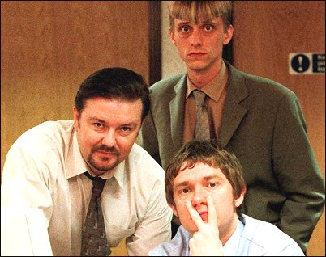
THE OFFICE

Slide 10
SATIRE
a comedic genre that involves criticism of society
by means of parody, irony, sarcasm, pastiche or caricature

Slide 11
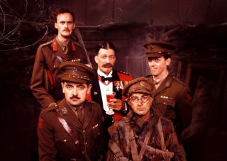
BLACKADDER

Slide 12
TOOLS OF COMEDY
word puns
irony
sarcasm
understatement
hyperbole
absurdist humour
slapstick
dark/black humour

Slide 13
PAIR WORK
Pick a joke / phrase
Tell the joke to your neighbour
Guess which ‘tool of comedy’ is used and write it down

Slide 14
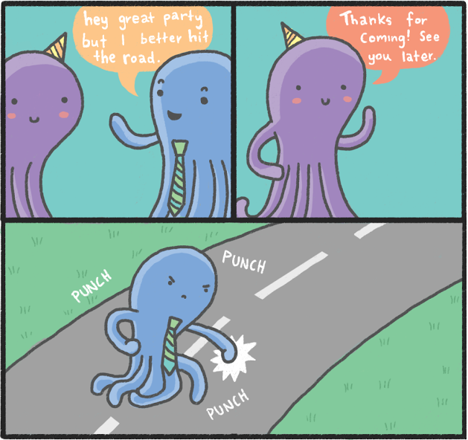
1. WORD PUN

Slide 15
2. IRONY
He’s as nice as a lion
to his prey.

Slide 16
3. HYPERBOLE
I’m so hungry I could eat a horse.

Slide 17
4. WORD PUN
A man is waiting on the bus. Another man walks by and yells: “Hey, get off that bus!”

Slide 18
5. WORD PUN
What do you call a black priest? Holy shit.

Slide 19
6. BLACK / DARK HUMOUR
Since it started to rain, my wife can’t stop looking through the window. If it will start pouring down, I’m afraid I will have to let her inside.

Slide 20
7. Absurdist humour
Two strawberries are in a jar of jam. One of the strawberries asks:
‘Can I sit by the window?’

Slide 21
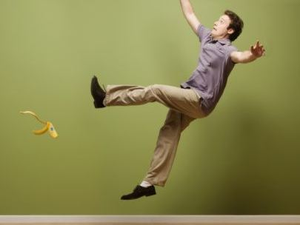
8. SLapstick

Slide 22
9. HYPERBOLE
If I can’t get a Smartphone, I will die.

Slide 23
10. IRONY
This chair is as comfort-able as sitting on nails.

Slide 24
11. Word pun
Why were the Middle Ages called the Dark Ages? Because there were so many knights.

Slide 25
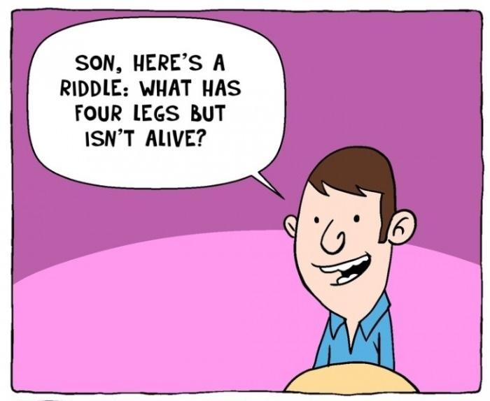
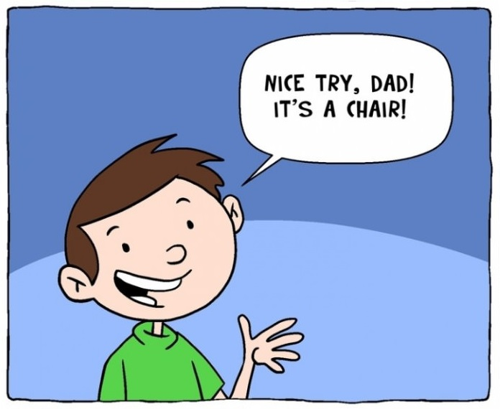
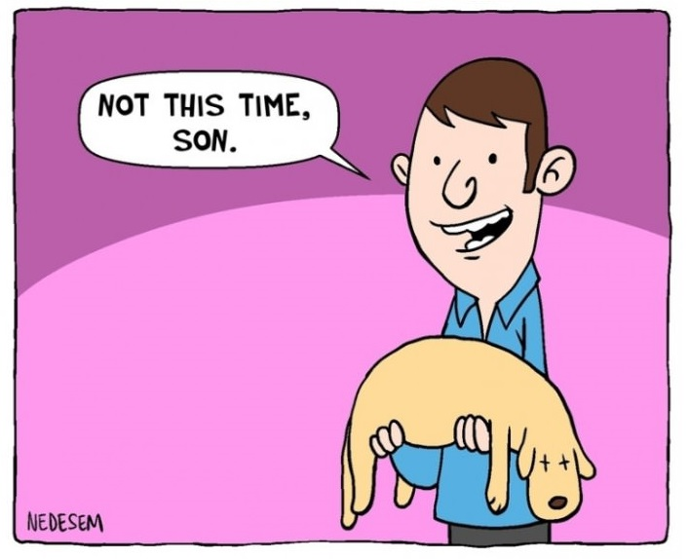
12. BLACk / DARK humour

Slide 26
13. WORD pun
Knock knock! Who’s there? Doris! Doris who? Doris locked, that’s why I am knocking!

Slide 27
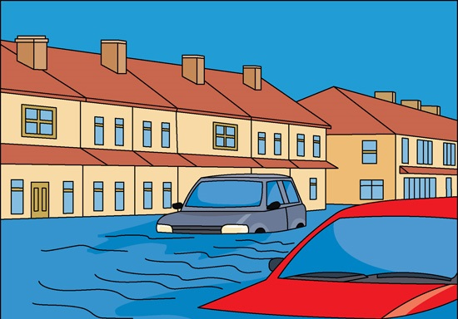
14. UNDerstatement
“We just had a little rain.”

Slide 28
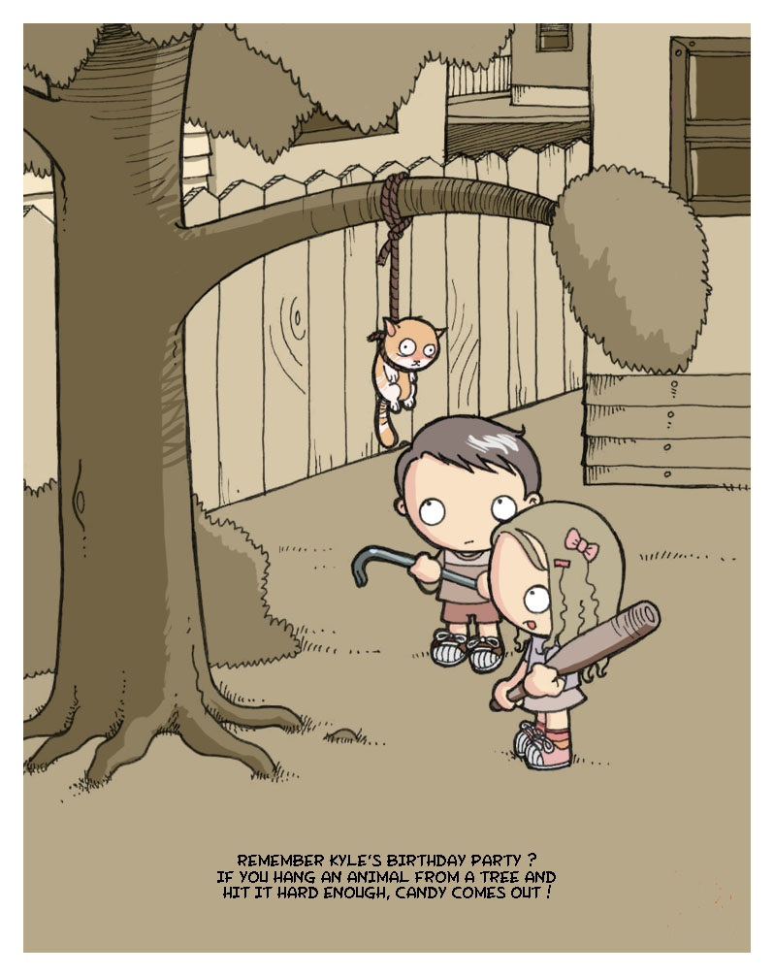
15. Black / dark humour

Slide 29
16. WORD pun
Did you hear about the guy whose whole left side was cut off? He’s all right now!

Slide 30
17. understatement
“I wouldn’t say it tasted great” – on absolutely terrible food.

Slide 31
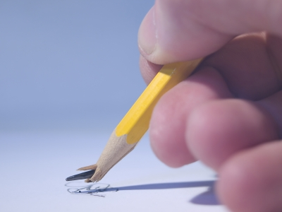
18. Word pun
Broken pencils are pointless.

Slide 32
19. ABSURDIST HUMOUR
There’s a professor who has crossed a chicken with a spider. He now has chickens with 8 legs. I said, ‘What does it taste like?’ He said, ‘I don’t know, I haven’t caught one yet.’

Slide 33
20. SARCASM
When something you have put a lot of effort and heart into goes very bad and someone swings the following at you: “That was a great success!”

Slide 34
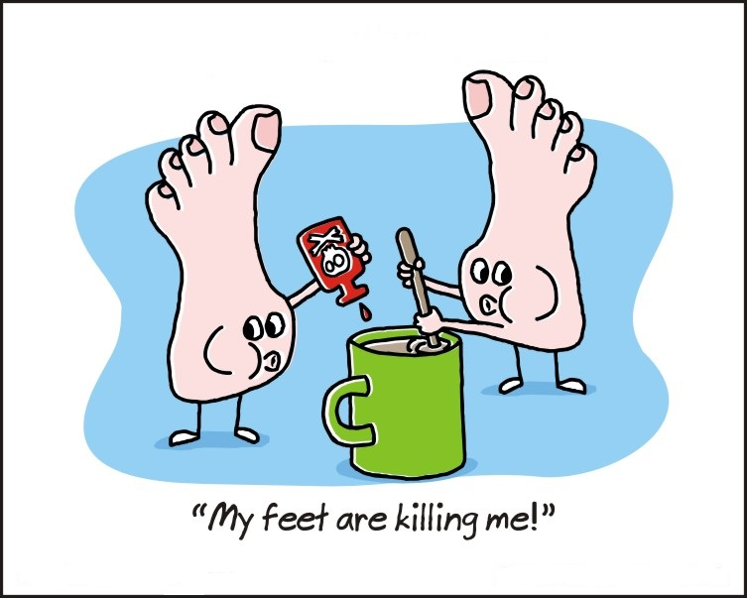
21. HYperbole

Slide 35
22. SARCASM
“I have had a perfectly wonderful evening, but this wasn’t it.”

Slide 36
23. Black / dark humour
How do children from Chernobyl count from one to hundred?
On their fingers!

Slide 37
24. SLAPSTICK

Slide 38
25. WORD PUN
Becoming a vegetarian was a missed steak.

Slide 39
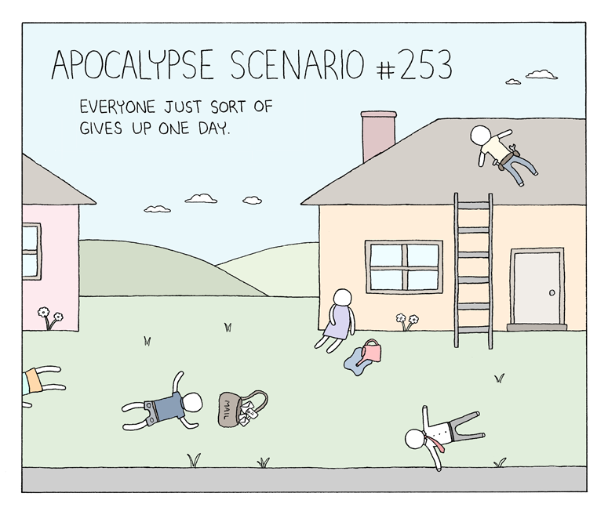
26. Absurdist humour

Slide 40
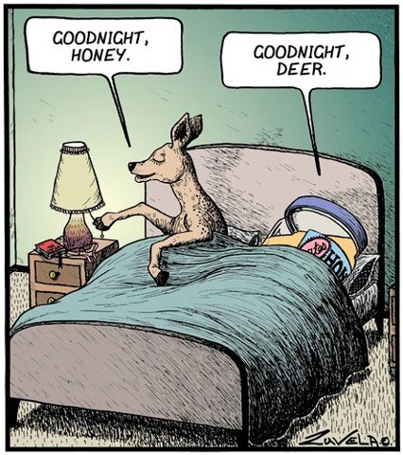
27. Word pun

Slide 41
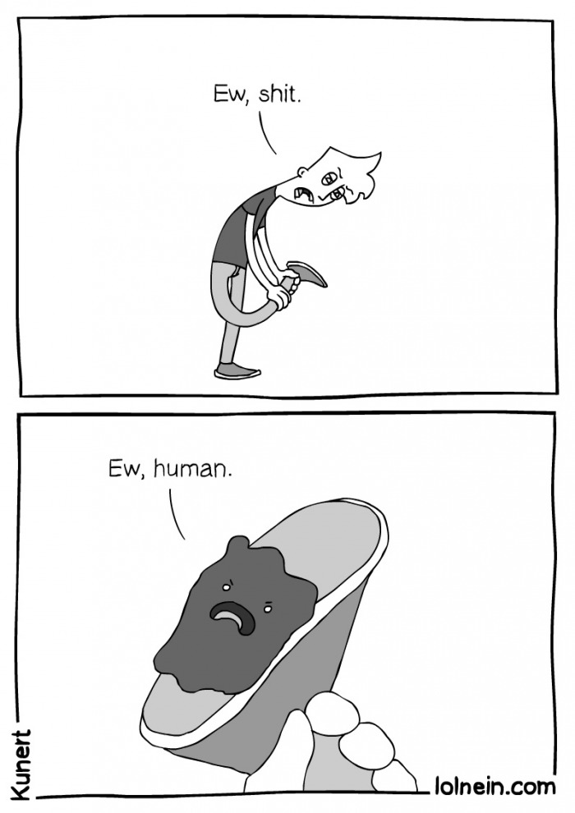
28. Absurdist humour

Slide 42
29. WORD PUN
Need an ark to save two of every animal? I noah guy.

Slide 43
30. understatement
“I have to have this operation. It isn’t very serious. I have this tiny little tumor on the brain.”
(Holden Caulfield in The Catcher in the Rye, by J.D. Salinger)

Slide 44
ASSIGNMENT
Form groups of 3 pupils
Re-enact a sketch of your choosing (2 – 5 min)

Slide 45
ASSIGNMENT
Hand in a written text of your script
Mark the tools of comedy (5) and name them
If needed you can adjust the text, add characters, elements, etc.
Use your imagination, you can do anything you want basically!

Slide 46
ASSIGNMENT
Assessment
Tools of comedy (5)
Performance (5)

Slide 47
ASSIGNMENT
SUGGESTIONS (SKETCH SHOWS)
Little Britain
Smack the Pony
Monty Python
Green Wing
The Two Ronnies
A Bit of Fry and Laurie
Benny Hills Show
French and Saunders
Not the Nine O’Clock News

